Slide 1

Online Encounter 23
Notes:
ENCOUNTER 23
REVIEW STUDENT PROGRESS
Check for last Encounter attendance.
Check for last Speaking Center attendance and time spent.
Check that Lesson 3 has been completed.
Prepare general comments on Student attendance, study habits, and overall progress.
VIDEO SUMMARY
Shen talks with his parents about plans for their upcoming trip to New York. Then Benny brings in mail for Shen. It’s a paycheck, and Shen explains to Benny that though he loves acting and is good at it, his recent jobs have not involved acting. Benny asks to borrow money from Shen.
Aanya invites Khae to go shopping with her over their lunch break. They buy a new tie for Marco, a necklace for Aanya, and a handbag for Khae.
At the restaurant, Sofi is pleased because she has taught the three temp cooks how to work well in the kitchen. Sofi’s friend Eli comes to the restaurant for lunch, and Sofi makes him one of her grandmother’s recipes. Diego helps one of the temp cooks with a recipe.
READING SUMMARY
In the first reading, two women, Kara and Yuna, are texting back and forth. Kara tells Yuna about some good deals she got on some clothing and accessories when shopping the night before. While planning a shopping trip together, Yuna asks Kara to borrow some money, which Kara avoids answering by claiming she’s too busy to chat.
The second reading is a “Plan Your Visit” page from a theme park’s website. Included are seasonal operating ours, directions to the park by bus and car, and information about a nearby hotel.
AUDIO SUMMARY
A man is starting to plan a vacation. He asks a friend to help him, and she guides him through the process of booking online. The man becomes interested in an all-inclusive trip until he finds out how high the price is.
VOCABULARY OBJECTIVES
Can name very common types of holiday (camping; tour; sightseeing)
Can use very basic language related to getting around a city (go to; get there; uptown, across the street; walk; by foot; take the bus; take the train)
GRAMMAR OBJECTIVES
Can describe everyday movements using basic prepositions (I get out of bed.)
Can ask for information about time, measurement, size, and quantity with how (How many vegetables?)
SPEAKING OBJECTIVES
Can make simple purchases by stating what is wanted and asking for the price (I want to buy some jewelry.)
Can ask for attention (Excuse me?)

Slide 2

Encounter 23
Introductions
Your teacher
My name is .
Now please introduce yourself.
Notes:
INSTRUCTIONS
This is a warm-up activity and should not be assessed.
Introduce yourself to the Students. Then ask each individual Student what his/her name is. Tell the Students:
Hello. My name’s _______. What’s your name?
Sample Responses: My name’s _______./My name is _______.
TEACHING TIPS
Ask the Students about their study habits. (e.g., “Have you finished your Speaking Center Lessons? How about your Student Manual or Digital Book?”)
Check for IT issues.

Slide 3

Part 1.0: Warm-Up
How/often/vacation?
Favorite trip?
When/last vacation?
?
How often do you go on vacation
?
What was your favorite trip
?
Can you make questions with these words?
When was your last vacation
Notes:
1.1 Find Out about Your Classmates (5 min)
Allow one minute for this slide.
OBJECTIVE
To help the Students relax and start thinking in English
INSTRUCTIONS
#1. Have a Student read the question. [Can you make questions with these words?]
#2. Encourage the Students to make questions based on the first cue. [How/often/vacation?]
#3. Reveal the first sample answer. [How often do you go on vacation?]
#4. Encourage the Students to answer based on the second cue. [Favorite trip?]
#5. Reveal the second sample answer. [What was your favorite trip?]
#6. Encourage the Students to answer based on the last cue. [When/last vacation?]
#7. Reveal the third sample answer. [When was your last vacation?]

Slide 4
Part 1.0: Warm-Up
How/often/vacation?
Favorite trip?
When/last vacation?
?
.
Notes:
1.1 Find Out about Your Classmates
Allow four minutes for this slide.
INSTRUCTIONS
Have the Students take turns asking and answering the questions.
Then, ask the Students, “Did you hear anything interesting from your partners?”
Encourage the Students to respond to each other’s travel experiences.

Slide 5

Part 2.0: Target Language
Activity 2.1: Context Creation
What are some things you can do when you go on vacation?
tour of a city
camping
sightseeing
walking tour
Notes:
2.1 Travel (5 min)
Allow one minute for this slide.
OBJECTIVE
Can name very common types of holiday (camping; tour; sightseeing)
INSTRUCTIONS
#1. Have a Student read the question. [What are some things you can do when you go on vacation?]
#2. Encourage the Students to answer.
#3. Reveal the sample answers. [sightseeing/camping/walking tour/tour of a city]
Ask the Students which of these activities they like. For example, “Do you like camping? Why or why not?”
TEACHING TIPS
Elicit a variety of the target vocabulary.
Elicit from each Student.
It helps to board elicited language.

Slide 6
Part 2.0: Target Language
Activity 2.1: Concept Check
What do you do when you go camping?
What do you do when you go sightseeing?
live in the forest and cook outside
visit museums and famous places
Notes:
2.1 Travel
Allow one minute for this slide.
INSTRUCTIONS
#1. Have a Student read the question. [What do you do when you go camping?]
#2. Encourage the Students to answer.
#3. Reveal the sample answer. [live in the forest and cook outside]
#4. Have a Student read the question. [What do you do when you go sightseeing?]
#5. Encourage the Students to answer.
#6. Reveal the sample answer. [visit museums and famous places]
TEACHING TIP
Elicit target language from each Student.

Slide 7




Part 2.0: Target Language
Activity 2.1: Practice
.
A
B
Do you like ?
C
D
Notes:
2.1 Travel
Allow two minutes for this slide.
INSTRUCTIONS
Have the Students take turns asking and answering “Do you like _______?” questions about the types of holidays they see on the screen.
ANSWER KEY (Sample Answers)
city tour
beach holiday
playing golf
sightseeing

Slide 8



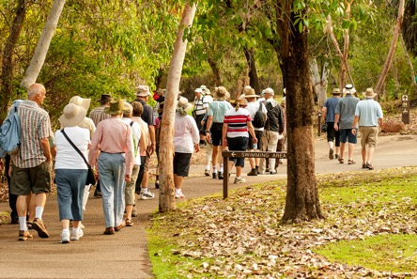
Part 2.0: Target Language
Activity 2.1: Practice
.
A
B
Do you like ?
C
D
Notes:
2.1 Travel
Allow one minute for this slide.
INSTRUCTIONS
Have the Students take turns asking and answering “Do you like _______?” questions about the types of holidays they see on the screen.
ANSWER KEY (Sample Answers)
going to museums
watching TV
camping
walking

Slide 9


Part 2.0: Target Language
Activity 2.1: Extension
.
.
Notes:
2.1 Travel
Optional Extension
INSTRUCTIONS
Tell the Students about either a personal experience from a holiday or a trip that you would like to take referring to one of the pictures from this activity. Then, with their classmates, have the Students discuss any of the types of vacations they have taken or would like to take.

Slide 10
Part 2.0: Target Language
Activity 2.1: Feedback
Student 1
Student 2
Student 3
Student 4
Great job!
Great job!
Great job!
Great job!
Well done
Well done
Well done
Well done
Good try
Good try
Good try
Good try
More practice
More practice
More practice
More practice
Feedback
Notes:
2.1 Travel
FEEDBACK
Quickly give the Students feedback on the target language they just practiced.
Remind them of other resources they can take advantage of to improve their English:
Go to Wall Street World to practice grammar and vocabulary.
Review the Student Manual or Digital Book to study grammar and vocabulary.
Attend Complementary Classes to practice using grammar and vocabulary.
Join Social Clubs to practice speaking skills.

Slide 11

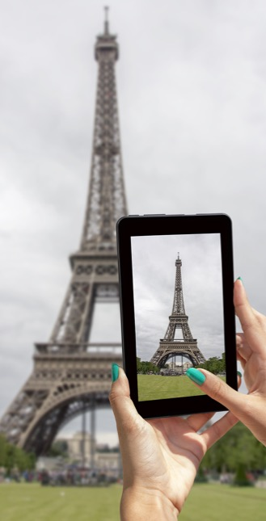
Part 2.0: Target Language
Activity 2.2: Context Creation
.
We can take the subway
.
We can go on foot
We’re in Paris on vacation, and we are staying at a hotel. We want to go to museums. Some are close to the hotel, but some aren’t. How can we get to the museums?
Notes:
Activity 2.2 Transportation (5 min)
Allow one minute for this slide.
OBJECTIVE
Can use very basic language related to getting around a city (go to; get there; uptown, across the street; walk; by foot; take the bus; take the train)
INSTRUCTIONS
#1. Have a Student read the statements and question. [We’re in Paris on vacation, and we are staying at a hotel. We want to go to museums. Some are close to the hotel, but some aren’t. How can we get to the museums?]
#2. Encourage the Students to answer.
#3. Reveal the sample answers. [We can take the subway./We can go on foot.]
TEACHING TIPS
Elicit a variety of the target vocabulary.
Elicit from each Student.
It helps to board elicited language.

Slide 12

Part 2.0: Target Language
Activity 2.2: Concept Check
We can the subway.
take
We can on foot.
go
Notes:
Activity 2.2 Transportation
Allow one minute for this slide.
INSTRUCTIONS
#1. Have a Student read the text, filling in the blank to complete the sentence.
#2. Reveal the answer. [We can take the subway.]
#3. Have a Student read the text, filling in the blank to complete the sentence.
#4. Reveal the answer. [We can go on foot.]
TEACHING TIP
Elicit target language from each Student.

Slide 13
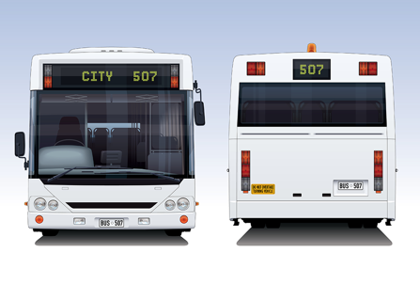

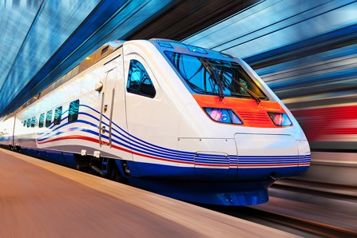
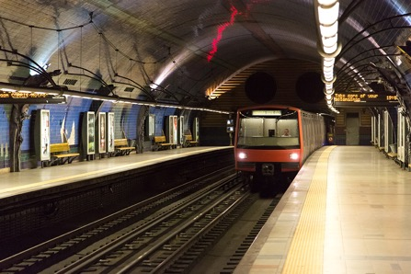
Part 2.0: Target Language
Activity 2.2: Practice
A
B
We/to the museum
Julia/to the restaurant
C
D
You/to London
We/get/by
Notes:
Activity 2.2 Transportation
Allow two minutes for this slide.
INSTRUCTIONS
Have the Students take turns making sentences about each picture. They should make two sentences per picture.
A: We can take the bus to the museum.
B: We can get the bus (there) to the museum.
ANSWER KEY (Sample Answers)
A. We can take the bus to the museum./We can get the bus (there) to the museum.
B. Julia can go/get to the restaurant by bus.
C. You can take the train to London./You can get to London by train.
D. We can get there by subway./We can take the subway there.

Slide 14

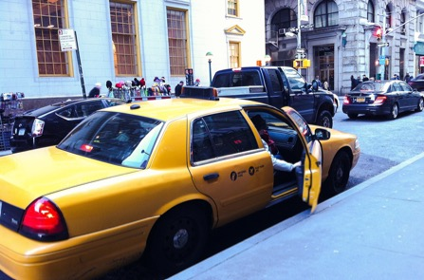
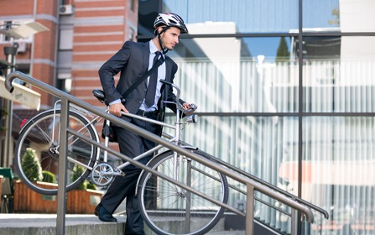

Part 2.0: Target Language
Activity 2.2: Practice
A
B
We/to the hotel
Mary/to the airport
C
D
He/to the mall
Paolo/to work every day
Notes:
Activity 2.2 Transportation
Allow one minute for this slide.
INSTRUCTIONS
Have the Students take turns making sentences about each picture. They should make two sentences per picture.
ANSWER KEY (Sample Answers)
We can go to the hotel on foot./We can walk to the hotel.
Mary can get/take a taxi to the airport.
He can go/get to the mall by bicycle.
Paulo can take his car/drive to work every day.

Slide 15
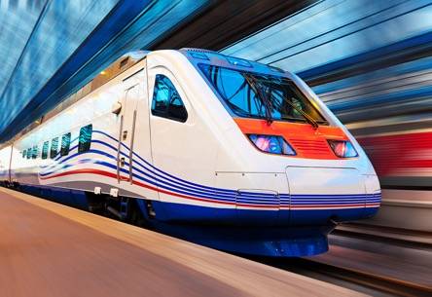
Part 2.0: Target Language
Activity 2.2: Extension
Do you like the train?
.
Notes:
Activity 2.2 Transportation
Optional Extension
INSTRUCTIONS
#1. Have a Student read the question. [Do you like the train?]
#2. Encourage the Students to answer based on their own personal opinions.
Follow up by asking them about the train with “why,” “how often,” and “where.”

Slide 16

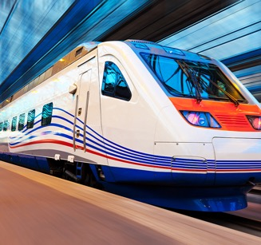
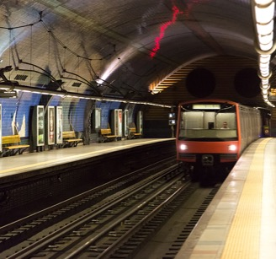

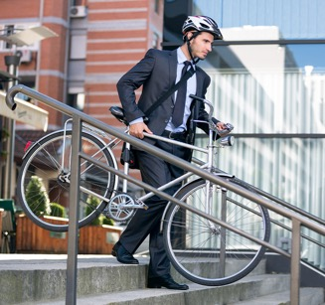

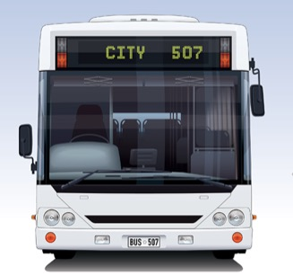
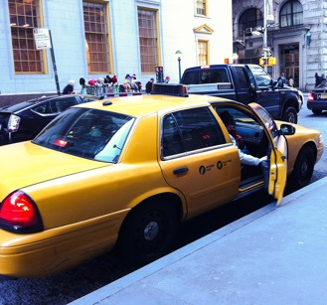
Part 2.0: Target Language
Activity 2.2: Extension
Notes:
Activity 2.2 Transportation
Optional Extension
INSTRUCTIONS
Have the Students discuss with their classmates which forms of transportation they like/don’t like and why they like/don’t like them.

Slide 17
Part 2.0: Target Language
Activity 2.2: Feedback
Student 1
Student 2
Student 3
Student 4
Great job!
Great job!
Great job!
Great job!
Well done
Well done
Well done
Well done
Good try
Good try
Good try
Good try
More practice
More practice
More practice
More practice
Feedback
Notes:
Activity 2.2 Transportation
FEEDBACK
Quickly give the Students feedback on the target language they just practiced.
Remind them of other resources they can take advantage of to improve their English:
Go to Wall Street World to practice grammar and vocabulary.
Review the Student Manual or Digital Book to study grammar and vocabulary.
Attend Complementary Classes to practice using grammar and vocabulary.
Join Social Clubs to practice speaking skills.

Slide 18
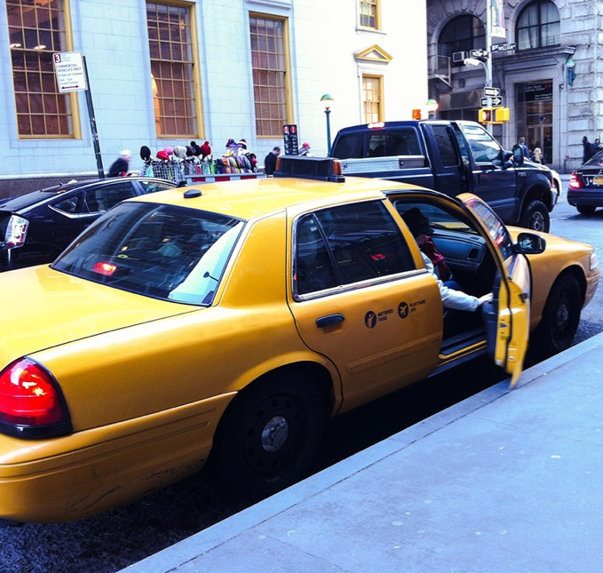
Part 3.0: Target Structures
Activity 3.1: Context Creation
Get the taxi.
We have to get the bus at 4th Street.
Let’s walk the museum.
out of
off
to
Notes:
3.1 Get on the Bus! (5 min)
Allow one minute for this slide.
OBJECTIVE
Can describe everyday movements using basic prepositions (I get out of bed.)
INSTRUCTIONS
#1. Have a Student read the text, filling in the blank to complete the sentence.
#2. Reveal the sample answer. [Get out of the taxi.]
#3. Have a Student read the text, filling in the blank to complete the sentence.
#4. Reveal the sample answer. [We have to get off the bus at 4th Street.]
#5. Have a Student read the text, filling in the blank to complete the sentence.
#6. Reveal the sample answer. [Let’s walk to the museum.]
TEACHING TIPS
Elicit examples of the target structure(s).
Elicit from each Student.
It helps to board elicited language.

Slide 19
Part 3.0: Target Structures
Activity 3.1: Concept Check
Do you say “walk to the museum” or “walk on the museum”?
walk to the museum
Notes:
3.1 Get on the Bus!
Allow one minute for this slide.
INSTRUCTIONS
#1. Have a Student read the question. [Do you say “walk to the museum” or “walk on the museum”?]
#2. Encourage the Students to answer.
#3. Reveal the answer. [walk to the museum]
TEACHING TIP
Elicit target language from each Student.

Slide 20

Part 3.0: Target Structures
Activity 3.1: Practice
Scenario
Students A and B
to
A: Do you want to go (1) the museum?
B: Yes. Let’s take the subway. We can get (2) it at Brooks Street.
A: I hate the subway. How about taking a bus? We can get (3) the bus at 4th Street.
B: OK. And where do we get (4) for the museum?
A: At Dunbar Avenue. Then we have to walk (5) the museum from there.
B: That’s a lot of walking! Let’s just take a taxi. We can tell the driver to go (6) the museum after we get (7) the taxi. That way we can get (8) the taxi right in front of the museum!
on
on
off
to
to
into
out of
Notes:
3.1 Get on the Bus!
Allow two minutes for this slide.
INSTRUCTIONS
Divide the class into pairs and draw the attention of Students A and B to the text on the screen.
Instruct these Students to work together to decide how to fill in the blanks in the dialogue.
After they discuss what can go in the gaps that they should then take on the role of A/B and perform the dialogue as a pair.
#1. Display the answers. [to/on/on/off/to/to/into/out of]
TEACHING TIP
When reviewing the answers, do not say an answer is correct immediately. Allow the Students the opportunity to ask questions and correct each other before confirming the correct answer.

Slide 21
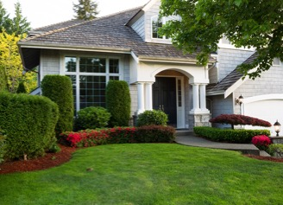
Part 3.0: Target Structures
Activity 3.1: Practice
Scenario
Students C and D
to
A: Do you want to go (1) my sister’s house?
B: Yes. Let’s take the bus. We can get (2) the bus at Post Road.
A: I hate the bus. How about taking the subway? We can get (3) the subway at 32nd Street.
B: OK. And where do we get (4) for your sister’s house?
A: At Liberty Road. Then we have to walk (5) my sister’s house.
B: That’s a lot of walking! Let’s just take a taxi. We can tell the driver to go your sister’s house after we get (7) the taxi. That way we can get (8) the taxi right in front of your sister’s house!
on
on
off
to
to
into
out of
Notes:
3.1 Get on the Bus!
Allow one minute for this slide.
INSTRUCTIONS
Draw the attention of Students C and D to the text on the screen.
Instruct these Students to work together to decide how to fill in the blanks in the dialogue.
After they discuss what can go in the gaps that they should then take on the role of A/B and perform the dialogue as a pair.
#1. Display the answers. [to/on/on/off/to/to/into/out of]
TEACHING TIP
When reviewing the answers, do not say an answer is correct immediately. Allow the Students the opportunity to ask questions and correct each other before confirming the correct answer.

Slide 22
Part 3.0: Target Structures
Activity 3.1: Practice
Student 1
Student 2
Student 3
Student 4
Great job!
Great job!
Great job!
Great job!
Well done
Well done
Well done
Well done
Good try
Good try
Good try
Good try
More practice
More practice
More practice
More practice
Feedback
Notes:
3.1 Get on the Bus!
FEEDBACK
Quickly give the Students feedback on the target language they just practiced.
Remind them of other resources they can take advantage of to improve their English:
Go to Wall Street World to practice grammar and vocabulary.
Review the Student Manual or Digital Book to study grammar and vocabulary.
Attend Complementary Classes to practice using grammar and vocabulary.
Join Social Clubs to practice speaking skills.

Slide 23
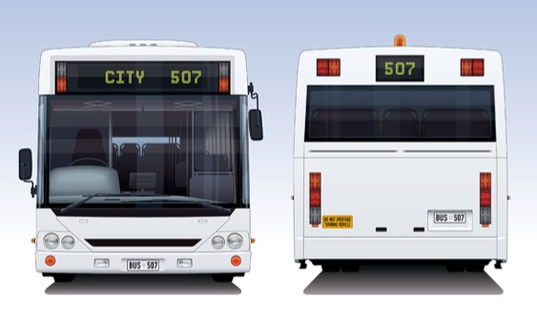
Part 3.0: Target Structures
Activity 3.2: Context Creation
?
How much is a bus ticket
We just talked about getting around a city. If you want to buy a bus ticket, and you don’t know the price, what can you ask?
Notes:
3.2 How Much Is It? (10 min)
Allow one minute for this slide.
OBJECTIVE
Can ask for information about time, measurement, size, and quantity with how (How many vegetables?)
INSTRUCTIONS
#1. Have a Student read the statement and question. [We just talked about going around a city. If you want to buy a bus ticket, and you don’t know the price, what can you ask?]
#2. Encourage the Students to answer.
#3. Reveal the sample answer. [How much is a bus ticket?]
TEACHING TIPS
The Students may not immediately supply questions with “how.” If this is the case, on the board, write,
_____ _____ is a bus ticket?
Elicit,
How much is a bus ticket?
Elicit examples of the target structure(s).
Elicit from each Student.
It helps to board elicited language.

Slide 24
Part 3.0: Target Structures
Activity 3.2: Context Creation
Last, you want to know the number of kilometers to the place. What question can you ask?
?
?
How far is…
How long does it take
You also want to know the time it takes to get to a place. What question can you ask?
Notes:
3.2 How Much Is It?
Allow one minute for this slide.
INSTRUCTIONS
#1. Have a Student read the statement and question. [You also want to know the time it takes to get to a place. What question can you ask?]
#2. Encourage the Students to answer.
#3. Reveal the sample answer. [How long does it take?]
#4. Have a Student read the statement and question. [Last, you want to know the number of kilometers to the place. What question can you ask?]
#5. Encourage the Students to answer.
#6. Reveal the sample answer. [How far is…?]
TEACHING TIPS
The Students may not immediately supply questions with “how.” If this is the case, on the board, write,
_____ _____ does it take?
Elicit,
How long does it take?
Do the same for “how far.”
Elicit examples of the target structure(s).
Elicit from each Student.
It helps to board elicited language.

Slide 25
Part 3.0: Target Structures
Activity 3.2: Concept Check
How much is a bus ticket in your city?
How long does it take to get from your home to school or work?
How far is it from your home to school or work?
Notes:
3.2 How Much Is It?
Allow one minute for this slide.
INSTRUCTIONS
#1. Have a Student read the question. [How much is a bus ticket in your city?]
#2. Encourage the Students to answer with their own personal information.
#3. Have a Student read the question. [How long does it take to get from your home to school or work?]
Encourage the Students to answer with their own personal information.
#4. Have a Student read the question. [How far is it from your home to school or work?]
Encourage the Students to answer with their own personal information.
TEACHING TIP
Elicit target language from each Student.

Slide 26
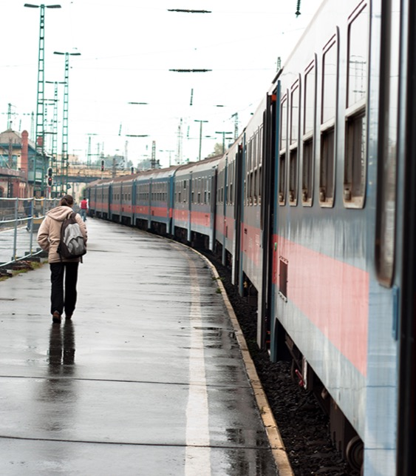
Part 3.0: Target Structures
Activity 3.2: Practice
Student A
Read these sentences.
You are at a train station and you want to buy a ticket.
You want to know if the train comes frequently.
You want to know the time it takes to go from the train station to the museum.
Student B
Listen and make a question with “how.”
Notes:
3.2 How Much Is It?
Allow two minutes for this slide.
INSTRUCTIONS
Assign two Students to work on this slide. Tell the Students to take turns reading the sentences on the screen to their classmate, who should respond with an appropriate question for the situation. For example,
A: You are at a train station and you want to buy a ticket.
B: How much is a train ticket?
ANSWER KEY (Sample Answers)
How much is a train ticket?
How often does the train come?
How long does it take to get to the museum?

Slide 27
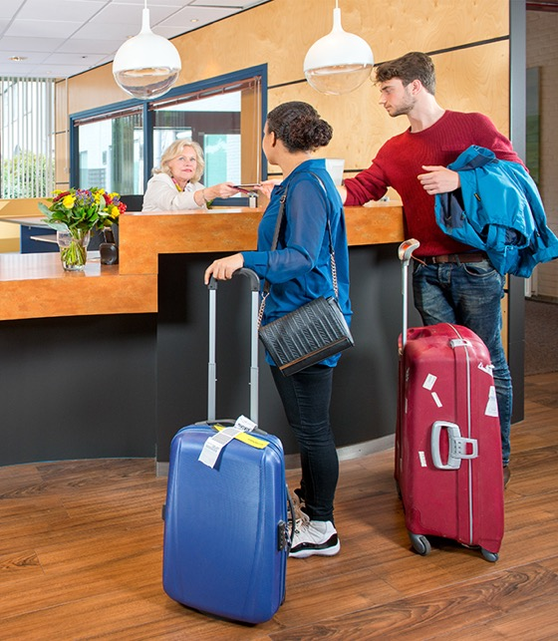
Part 3.0: Target Structures
Activity 3.2: Practice
Student C
Read these sentences
You want to know the price of a room at a hotel.
You want to know if the hotel room is big.
You want to know if you can walk to the train station from the hotel.
Student D
Listen and make a question with “how.”
Notes:
3.2 How Much Is It?
Allow two minutes for this slide.
INSTRUCTIONS
Assign two Students to work on this slide. Tell the Students to take turns reading the sentences on the screen to their classmate, who should respond with an appropriate question for the situation.
ANSWER KEY (Sample Answers)
How much is a room at the hotel?
How big is the room?
How can I walk to the train station from the hotel?

Slide 28
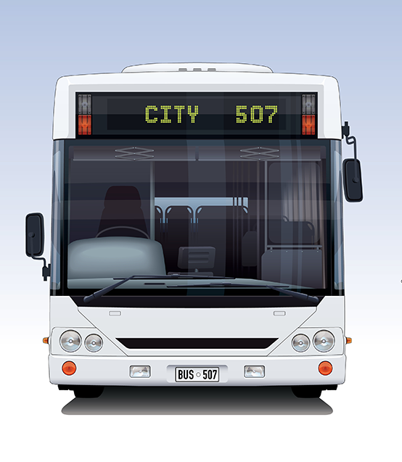
Part 3.0: Target Structures
Activity 3.2: Practice
Student A
Read these sentences.
You are at bus station and you want to buy a ticket.
You want to know if the bus comes frequently.
You want to know the time it takes to go from the bus station to the airport.
Student B
Listen and make questions with “how.”
Notes:
3.2 How Much Is It?
Allow two minutes for this slide.
INSTRUCTIONS
Assign two Students to work on this slide. Tell the Students to take turns reading the sentences on the screen to their classmate. The other Student should listen to each sentence and respond with two to three questions related to the situation. For example,
A: I’d like to go to the airport. How much is a bus ticket?
B: It’s ten dollars.
A: OK, here you are. And how long is the trip to the airport?
B: It’s about an hour.
ANSWER KEY (Sample Answers)
How much is a train ticket?
How often does the train come?
How long does it take to get to the airport?

Slide 29
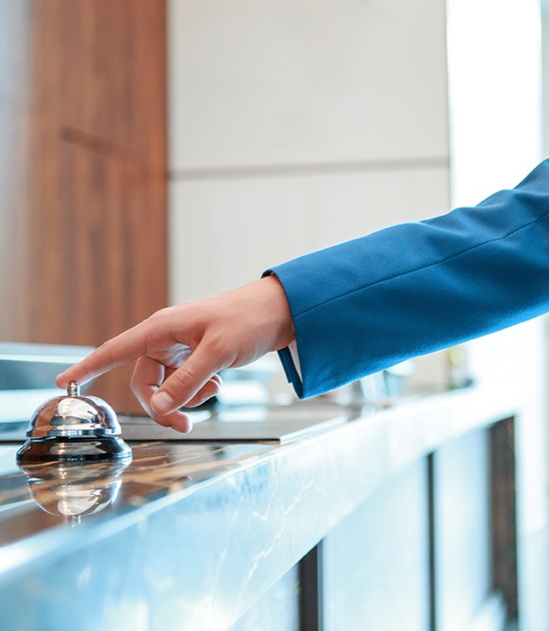
Part 3.0: Target Structures
Activity 3.2: Practice
Student C
Read these sentences
You want to know the price of a room at a motel.
You want to know if the motel room is big.
You want to know if you can walk
to the bus station from the motel.
Student D
Listen and make questions with “how.”
Notes:
3.2 How Much Is It?
Allow one minute for this slide.
INSTRUCTIONS
Assign two Students to work on this slide. Tell the Students to take turns reading the sentences on the screen to their classmate. The other Student should listen to each sentence and respond with two to three questions related to the situation.
ANSWER KEY (Sample Answers)
How much is a room at the hotel?
How big is the room?
How can I walk to the bus station from the hotel?

Slide 30
Part 3.0: Target Structures
Activity 3.2: Feedback
Student 1
Student 2
Student 3
Student 4
Great job!
Great job!
Great job!
Great job!
Well done
Well done
Well done
Well done
Good try
Good try
Good try
Good try
More practice
More practice
More practice
More practice
Feedback
Notes:
3.2 How Much Is It?
FEEDBACK
Quickly give the Students feedback on the target language they just practiced.
Remind them of other resources they can take advantage of to improve their English:
Go to Wall Street World to practice grammar and vocabulary.
Review the Student Manual or Digital Book to study grammar and vocabulary.
Attend Complementary Classes to practice using grammar and vocabulary.
Join Social Clubs to practice speaking skills.

Slide 31

Part 4.0: Communication
Activity 4.1: Context Creation
What can you do on vacation?
tour of the city
camping
sightseeing
walking tour
Notes:
4.1 Booking a Tour (15 min)
Allow one minute for this slide.
OBJECTIVES
Can name very common types of holiday (camping; tour; sightseeing)
Can ask for information about time, measurement, size, and quantity with how (How many vegetables?)
Can make simple purchases by stating what is wanted and asking for the price (I want to buy some jewelry.)
INSTRUCTIONS
Ask the Students to recall what they have done thus far in the Encounter.
#1. Have a Student read the question. [What can you do on vacation?]
#2. Encourage the Students to answer.
#3. Reveal the sample answers. [sightseeing/camping/walking tour/tour of the city]
TEACHING TIPS
Brainstorm/Elicit a variety of the target language, which will be used and assessed during the practice.
Elicit from each Student.
It helps to board elicited language.

Slide 32
Part 4.0: Communication
Activity 4.1: Context Creation
Today you are going to buy a ticket over the phone.
You want to go on a tour of a city. What do you have to do?
Where can you go to find information about tours?
.
find information about different tours
We can go online or to an information office
Notes:
4.1 Booking a Tour
Allow two minutes for this slide.
INSTRUCTIONS
#1. Have a Student read the statement and the question. [You want to go on a tour of a city. What do you have to do?]
#2. Encourage the Students to answer.
#3. Reveal the sample answer. [find information about different tours]
#4. Have a Student read the question. [Where can you go to find information about tours?]
#5. Encourage the Students to answer.
#6. Reveal the sample answers. [We can go online or to an information office.]
#7. Have a Student read the statement. [Today you are going to buy a ticket over the phone.]
Elicit some language related to asking for information over the phone. Ask, “What do you need to think about before choosing a tour?” (price, places to see, etc.)
Then ask, “How can you ask about price?” (How much is…)
Finally, ask, “What can you say to ask for information about a tour?” (I’d like to get some information about…)
TEACHING TIPS
Brainstorm/Elicit a variety of the target language, which will be used and assessed during the practice.
Elicit from each Student.
It helps to board elicited language.

Slide 33

Part 4.0: Communication
Activity 4.1: Practice
Scenario
Student A: Tourist
Student B: Information
Package deals the company has?
What each deal includes
The price of the deals
Hotels and food
(You DO NOT want to buy one of the package deals right now. You ONLY want information about the package deals.)
Package Deal #1: New York City Sightseeing
Includes breakfast, lunch, and hotels. Customers choose what they want to see (Empire State Building, museums, etc.). Price: $400 per person
Package Deal #2: Ocean and Beaches
Includes breakfast, lunch, and dinner. Two kinds of hotel rooms: big (two beds), small (one bed).
Hotel is on the beach.
Price: $300 per person
Notes:
4.1 Booking a Tour
Allow six minutes for this slide.
INSTRUCTIONS
Divide the Students into pairs and draw the Students’ attention to the text on the screen.
Tell Student A, “You want to choose a package deal for a weekend vacation for this weekend. You call a company that has many different kinds of weekend vacation package deals. You need to ask for the information on the screen.”
Tell Student B, “You work for a company that sells weekend vacation package deals. A customer calls you to ask for information about the package deals that you have. Right now, there are only two deals left for this weekend.”
Have the Students complete the role-play and then instruct them to switch roles and do the role-play again, but this time with only a minute to prepare.

Slide 34

Part 4.0: Communication
Activity 4.1: Practice
Scenario
Student C: Tourist
Student D: Information
Package deals the company has?
What each deal includes
The price of the deals
Hotels and food
(You DO NOT want to buy one of the package deals right now. You ONLY want information about the package deals.)
Package Deal #1: London Sightseeing
Includes breakfast, lunch, and hotels. Customer chooses what they want to see (museums, etc.).
Price: $900 per person
Package Deal #2: Ocean and Beaches
Includes breakfast, lunch, and dinner. Two kinds of hotel rooms: medium (one big bed), small (one bed). Hotel is on the beach.
Price: $125 per person
Notes:
4.1 Booking a Tour
Allow six minutes for this slide.
INSTRUCTIONS
Divide the Students into pairs and draw the Students’ attention to the text on the screen.
Tell Student C, “You want to choose a package deal for a weekend vacation for this weekend. You call a company that has many different kinds of weekend vacation package deals. You need to ask for the information on the screen.”
Tell Student D, “You work for a company that sells weekend vacation package deals. A customer calls you to ask for information about the package deals that you have. Right now, there are only two deals left for this weekend.”
Have the Students complete the role-play and then instruct them to switch roles and do the role-play again, but this time with only a minute to prepare.

Slide 35
Part 4.0: Communication
Activity 4.1: Feedback
 |  | Great job! | Well done | Good try | Need more practice
Student 1 | Range: How well you produce a range of language
 | Accuracy: How often you make mistakes
 | Quality of interaction: How well you ask and answer questions
 | Fluency and Spoken Production: How clearly you present ideas
Student 2 | Range: How well you produce a range of language
 | Accuracy: How often you make mistakes
 | Quality of interaction: How well you ask and answer questions
 | Fluency and Spoken Production: How clearly you present ideas
Student 3 | Range: How well you produce a range of language
 | Accuracy: How often you make mistakes
 | Quality of interaction: How well you ask and answer questions
 | Fluency and Spoken Production: How clearly you present ideas
Student 4 | Range: How well you produce a range of language
 | Accuracy: How often you make mistakes
 | Quality of interaction: How well you ask and answer questions
 | Fluency and Spoken Production: How clearly you present ideas
Notes:
4.1 Booking a Tour
FEEDBACK
Quickly give the Students feedback on the target language they just practiced.
If you have a full class, focus on just a couple points each (i.e., their greatest strength and what they need to work on).
Remind them of other resources they can take advantage of to improve their English:
Go to Wall Street World to practice grammar and vocabulary.
Review the Student Manual or Digital Book to study grammar and vocabulary.
Attend Complementary Classes to practice using grammar and vocabulary.
Join Social Clubs to practice speaking skills.

Slide 36
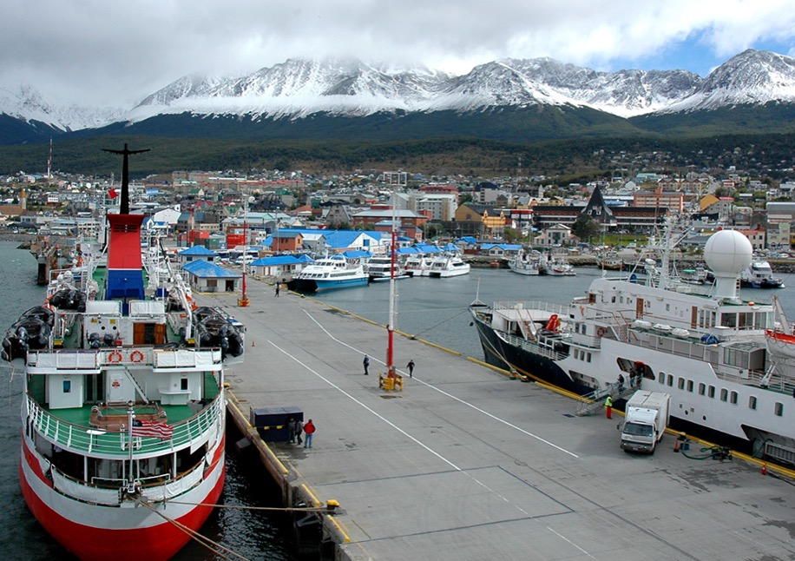
Part 4.0: Communication
Activity 4.2: Context Creation
.
Where do tourists go when they visit your city?
Notes:
4.2 Asking for Directions (10 min)
Allow one minute for this slide.
OBJECTIVES
Can use very basic language related to getting around a city (go to; get there; uptown, across the street; walk; by foot; take the bus; take the train)
Can describe everyday movements using basic prepositions (I get out of bed.)
Can ask for attention (Excuse me?)
INSTRUCTIONS
#1. Have a Student read the question. [Where do tourists go when they come to your city?]
#2. Elicit some well-known locations in the city that the Students are in.
TEACHING TIPS
Brainstorm/Elicit a variety of the target language, which will be used and assessed during the practice.
Elicit from each Student.
It helps to board elicited language.

Slide 37
Part 4.0: Communication
Activity 4.2: Context Creation
Imagine you are tourist in this city. You want to go to Beagle Channel, but you don’t know how to get there. What do you need to do?
Notes:
4.2 Asking for Directions
Allow two minutes for this slide.
INSTRUCTIONS
#1. Have a Student read the statements and question. [Imagine you are tourist in this city. You want to go to Beagle Channel, but you don’t know how to get there. What do you need to do?]
Elicit “Ask for directions.”
Then ask the Students how they will ask for directions if they don’t know anyone. Ask, “Who can you ask for directions?”
Elicit an answer. For example,
You can ask someone on the street.
Then say, “You don’t know that person. What do you say to stop him or her and get his or her attention?”
Elicit ways to ask for attention. For example,
Excuse me.
Can I ask you something?
Then ask the Students how they will ask for directions. Say, “You want to ask for directions. What can you say?”
Elicit language that will enable the Students to ask for and give directions. For example,
Can you give me directions to…?
Take a bus from… and get off at…
Walk to the bus stop in front of…and get on bus number…
TEACHING TIPS
Brainstorm/Elicit a variety of the target language, which will be used and assessed during the practice.
Elicit from each Student.
It helps to board elicited language.

Slide 38
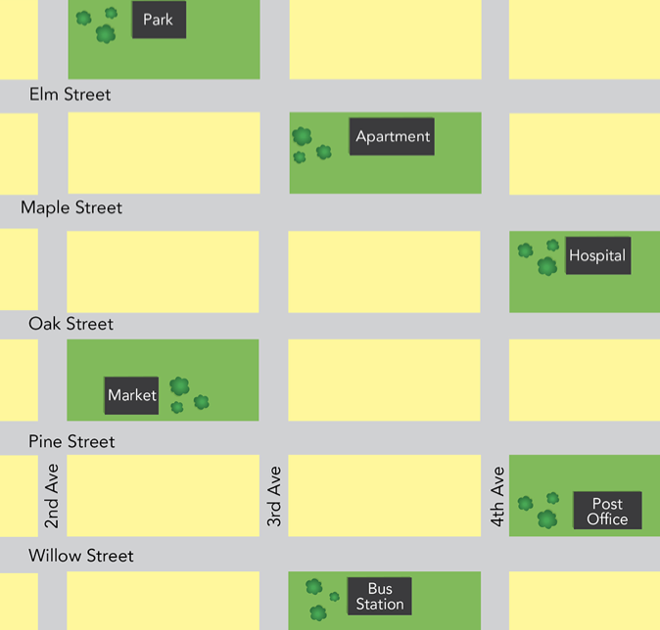
Part 4.0: Communication
Activity 4.2: Practice
Notes:
4.2 Asking for Directions
Allow seven minutes for this slide.
INSTRUCTIONS
Tell one Student where they are. That student should choose a place they want to go and ask another student for directions to that place. Repeat with each Student asking how to get somewhere and describing how to get somewhere several times. For example:
Teacher: Student A, you are at the park. Where do you want to go?
Student A: I want to go to the hospital. Student B, can you give me directions to the hospital?
Student B: Yes. First walk to 5th Ave....

Slide 39
Part 4.0: Communication
Activity 4.2: Feedback
 |  | Great job! | Well done | Good try | Need more practice
Student 1 | Range: How well you produce a range of language
 | Accuracy: How often you make mistakes
 | Quality of interaction: How well you ask and answer questions
 | Fluency and Spoken Production: How clearly you present ideas
Student 2 | Range: How well you produce a range of language
 | Accuracy: How often you make mistakes
 | Quality of interaction: How well you ask and answer questions
 | Fluency and Spoken Production: How clearly you present ideas
Student 3 | Range: How well you produce a range of language
 | Accuracy: How often you make mistakes
 | Quality of interaction: How well you ask and answer questions
 | Fluency and Spoken Production: How clearly you present ideas
Student 4 | Range: How well you produce a range of language
 | Accuracy: How often you make mistakes
 | Quality of interaction: How well you ask and answer questions
 | Fluency and Spoken Production: How clearly you present ideas
Notes:
4.2 Asking for Directions
FEEDBACK
Quickly give the Students feedback on the target language they just practiced.
If you have a full class, focus on just a couple points each (i.e. their greatest strength and what they need to work on).
Remind them of other resources they can take advantage of to improve their English:
Go to Wall Street World to practice grammar and vocabulary.
Review the Student Manual or Digital Book to study grammar and vocabulary.
Attend Complementary Classes to practice using grammar and vocabulary.
Join Social Clubs to practice speaking skills.

Slide 40
Encounter 23
Overall Feedback
 |  | Great job! | Well done | Good try | Need more practice
 | Activity 2.1: Travel
 | Activity 2.2: Transportation
 | Activity 3.1: Get on the Bus!
 | Activity 3.2: How Much Is It?
 | Activity 4.1: Booking a Tour
 | Activity 4.2: Asking for Directions
Student 1
Feedback
Notes:
OVERALL FEEDBACK (3–5 min)
Allow one minute for this slide.
Explain to the Students that you will now be giving them an overall assessment and recommendations. Use the following prompts to help you explain the assessment:
First, you did a really good job of…
The areas where you could use a little more practice are…
The language points I didn’t hear you use were...
As a result, I’d recommend that you… [continue on to Unit 24… work on (X, Y, Z ) and repeat Encounter 23].
Do you have any questions?

Slide 41
Encounter 23
Overall Feedback
 |  | Great job! | Well done | Good try | Need more practice
 | Activity 2.1: Travel
 | Activity 2.2: Transportation
 | Activity 3.1: Get on the Bus!
 | Activity 3.2: How Much Is It?
 | Activity 4.1: Booking a Tour
 | Activity 4.2: Asking for Directions
Student 2
Feedback
Notes:
OVERALL FEEDBACK (3–5 min)
Allow one minute for this slide.
Explain to the Students that you will now be giving them an overall assessment and recommendations. Use the following prompts to help you explain the assessment:
First, you did a really good job of…
The areas where you could use a little more practice are…
The language points I didn’t hear you use were...
As a result, I’d recommend that you… [continue on to Unit 24… work on (X, Y, Z ) and repeat Encounter 23].
Do you have any questions?

Slide 42
Encounter 23
Overall Feedback
 |  | Great job! | Well done | Good try | Need more practice
 | Activity 2.1: Travel
 | Activity 2.2: Transportation
 | Activity 3.1: Get on the Bus!
 | Activity 3.2: How Much Is It?
 | Activity 4.1: Booking a Tour
 | Activity 4.2: Asking for Directions
Student 3
Feedback
Notes:
OVERALL FEEDBACK (3–5 min)
Allow one minute for this slide.
Explain to the Students that you will now be giving them an overall assessment and recommendations. Use the following prompts to help you explain the assessment:
First, you did a really good job of…
The areas where you could use a little more practice are…
The language points I didn’t hear you use were...
As a result, I’d recommend that you… [continue on to Unit 24… work on (X, Y, Z ) and repeat Encounter 23].
Do you have any questions?

Slide 43
Encounter 23
Overall Feedback
 |  | Great job! | Well done | Good try | Need more practice
 | Activity 2.1: Travel
 | Activity 2.2: Transportation
 | Activity 3.1: Get on the Bus!
 | Activity 3.2: How Much Is It?
 | Activity 4.1: Booking a Tour
 | Activity 4.2: Asking for Directions
Student 4
Feedback
Notes:
OVERALL FEEDBACK (3–5 min)
Allow one minute for this slide.
Explain to the Students that you will now be giving them an overall assessment and recommendations. Use the following prompts to help you explain the assessment:
First, you did a really good job of…
The areas where you could use a little more practice are…
The language points I didn’t hear you use were...
As a result, I’d recommend that you… [continue on to Unit 24… work on (X, Y, Z ) and repeat Encounter 23].
Do you have any questions?

Slide 44
Part 5.0: Wrap-Up
.
Your friend from London is coming to visit your city for only one day. Where do you want to take him or her? What foods can he or she try? What are fun things to do?
Notes:
5.1 A Visit from a Friend (5 min)
Allow five minutes for this slide.
OBJECTIVE
• To review and practice target language from the Unit
INSTRUCTIONS
#1. Have a Student read the statement and questions. [Your friend from London is coming to visit your city for only one day. Where do you want to take him or her? What foods can he or she try? What are fun things to do?]
#2. The Students work with their classmates to outline a list of sights, things to do, foods to eat, etc., that the visitor can do in their city in one day.
TEACHING TIP
If you have time, assign one Student the role of reporter. It will be his/her job to take down all the information that is discussed, the locations the Students decide to visit, etc., and that person will also present the results of the discussion.
If the Students are in different cities, have them choose from among the different options available in each city to make a multi-city tour. They should imagine that they can instantly travel between cities.

Slide 45

Thank you for coming.
We hope you enjoyed the class.
Don’t forget
to leave feedback!
Teacher
Class was fun
Instructions were clear
«««««
«««««
«««««
«««««
«««««
«««««

Slide 46
© 2017 by Pearson Education Limited All rights reserved.
No part of this publication may be reproduced, stored in a retrieval system, or transmitted in any form or by any means, electronic, mechanical, photocopying, recording or otherwise without the permission of the Publishers.
This material is the intellectual property of Pearson Education Limited.
Image Credits:
Syda Productions/Fotolia; ZaZa studio/Fotolia; Warren Goldswain/Fotolia; Alextype/ Fotolia; smuki/Fotolia; AstroBoi/Fotolia; Oleksiy Mark/Fotolia; golubovy/Fotolia; Topanga/Fotolia; Igor Mojzes/Fotolia; Sergii Figurnyi/Fotolia; anyaberkut/Fotolia; tab62/Fotolia; Oliver Sved/Fotolia; corepics/Fotolia; Viacheslav Iakobchuck/Fotolia; Romolo Tavani/Fotolia; Nikolai Soroking/Fotolia; skyf/Fotolia

